Slide 1
COVID Mortality in Indiana A state with Mixed Vaccination Rates
A look at the COVID pandemic by county in Indiana

Slide 2
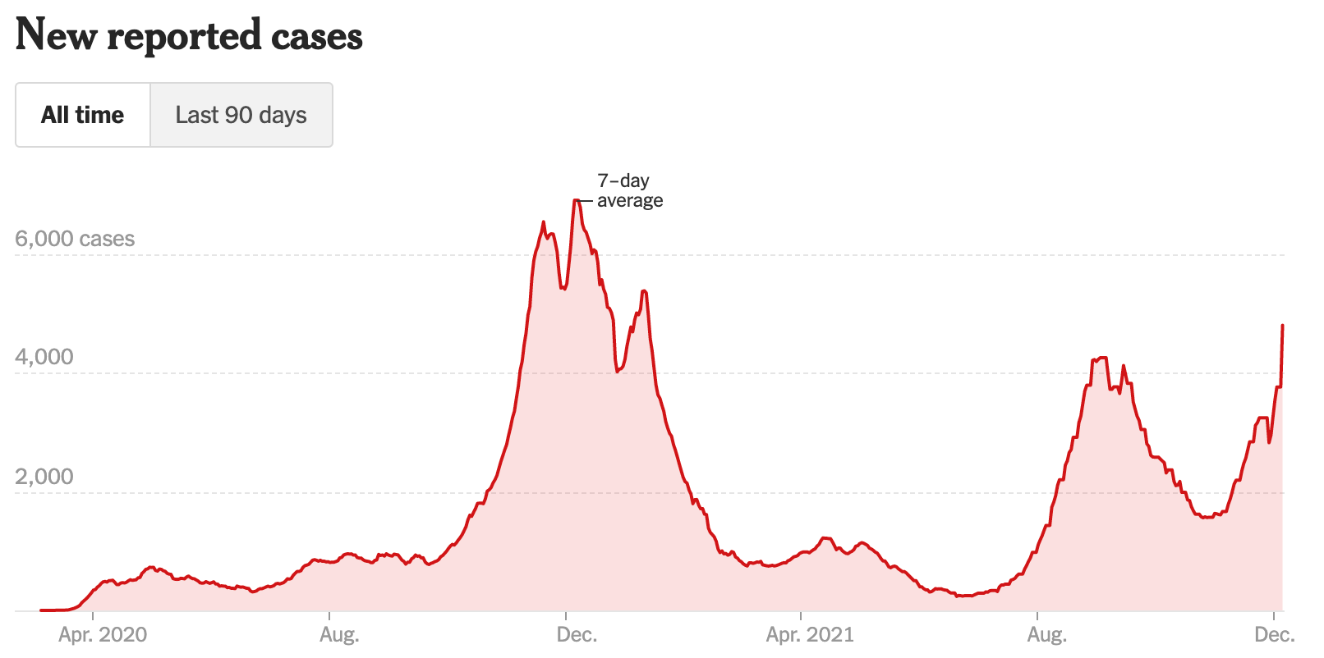
Background
Indiana has always been in the middle of the pack when responding to COVID
Ranks 29th on Sykes state response COVID rankings
Ranks 24th for Covid testing
Reported cases peaked in December 2020
Drop off in reported cases the following spring as vaccines become available
Cases increasing again late in 2021 as new variant spreads
Reported Cases as of Dec. 7th, 2021
Notes:
When it comes to responding to COVID-19, Indiana has always been in the middle of the pack
Indiana ranks 29th on Sykes state response COVID ranking and ranks 24th for COVID testing
The amount of reported cases in Indiana peaked in December 2020
As vaccines became available in the spring, there was a drop off in reported cases
And as a new variant began to spread in late 2021, cases have begun increasing again

Slide 3
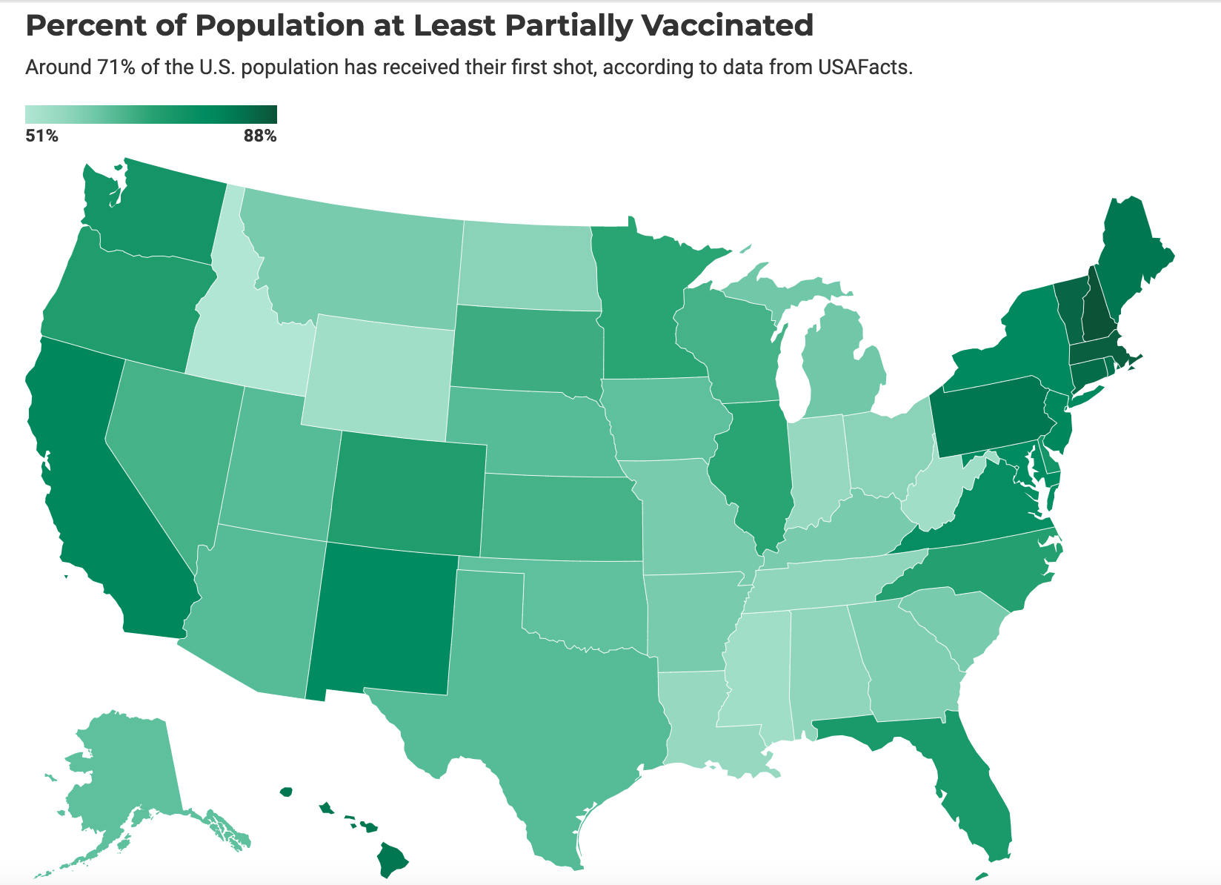
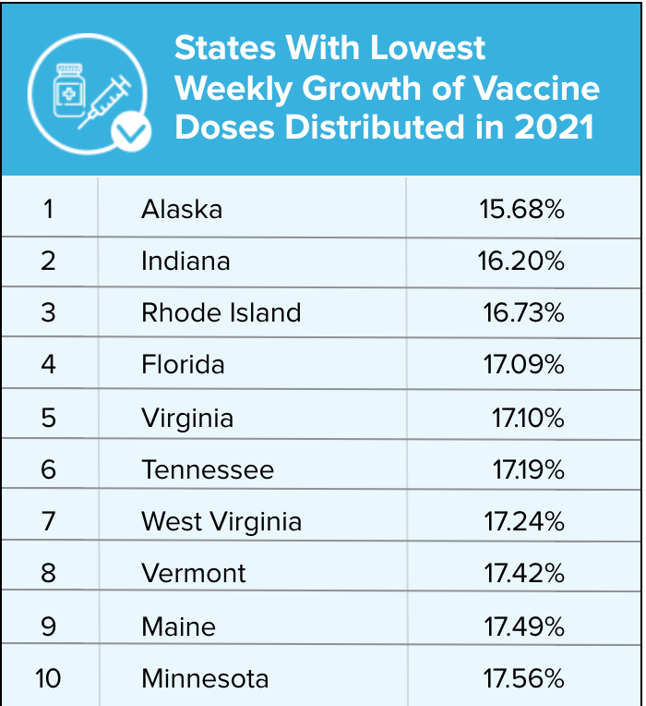
Background
Why has Indiana lagged behind other States?
2nd lowest weekly growth of vaccine doses distributed
One of the lowest partial vaccination rates in the country
Notes:
Why has Indiana lagged behind other states during the COVID-19 pandemic?
Indiana has the 2nd lowest weekly growth of vaccine doses distributed and has one of the lowest partial vaccination rates in the country

Slide 4
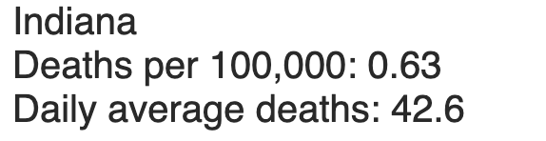
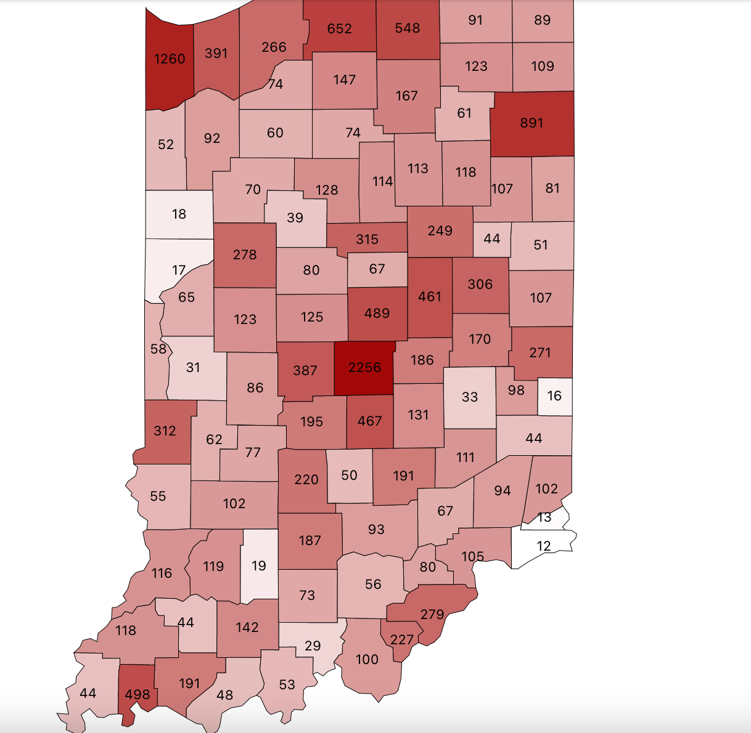
Background
Indiana also has the 12th highest Covid death rate
Why is this?
Population demographics such as age and high risk affect the mortality rate
Generally, counties with more at risk people and a larger proportion of older populations have a higher COVID death rate
Marion County:
Largest number of 65 and older/ high risk population
Highest number of COVID deaths
Largest county in Indiana by population
Pulaski County:
One of the highest Covid mortality rates in Indiana at 470 deaths per 100k people
High proportion of people over 65: around 21%
Notes:
Additionally, Indiana also has the 12th highest COVID-19 death rate, why is this?
Because population demographics such as age and high risk affect the mortality rate and
Generally, counties with more at risk people and older populations have a higher COVID death rate
Marion County has been found to have the:
Largest number of 65 and older/high risk population
The highest number of COVID deaths
And is the largest county in Indiana by population
Pulaski County is found to have:
One of the highest COVID mortality rates in Indiana at 470 deaths per 100k people
A high proportion of people over 65-around 21%

Slide 5
Research Question
General Research Question: What characteristics primarily affect the death rate from Covid-19 in the state of Indiana by county?
Explanatory Variables:
Vaccine Rate (B₁) - Number of vaccinated individuals per 100k people (by county)
Infection Rate (B₂) - Number of Covid cases per 100k people (by county)
Age (B₃) - Average age of Covid death (by county)
Gender (B₄) - Difference between number of male and female deaths (by county) per 100k population/negative indicates more female deaths/ positive indicates more male deaths
Percentage of High Risk (B₅) - Number of high risk individuals per 100k population (65 and older / severe medical conditions per county)
Primary Response Variable: Total Covid death Count (by county population)
Notes:
The general research question we will be exploring is “what characteristics primarily affect the death rate from COVID-19 in the state of Indiana by county?”
The explanatory variables we will be using for this are:
Vaccine Rate
Infection Rate
Age
Gender
And Percentage of High Risk
The primary response variable we will be using is:
The total COVID death count, measured by county population

Slide 6
Research Questions
Question 1:
Does infection rate and the vaccine rate have a significant linear impact on the COVID-19 death rate?
H₀: B₁=0 or B₂=0 (There is no evidence of linear impact showing that infection rate and/or vaccine rate impact the death rate by county.)
Hₐ: B₁≠0 or B₂≠0 (There is evidence of linear impact from at least one variable showing that infection rate and/or vaccine rate linearly affect the death rate by county.)
Question 2:
Do demographic factors such as age and gender have a significant linear effect on the COVID death rate/population of each county?
H₀: B₃=0 or B₄=0 (There is no linear impact from a person's age or gender on the death rate/population within the county.)
Hₐ: B₃≠0 and B₄≠0 (At least one of the variables (age or gender) has a linear impact on the death rate/population within the county.)
Question 3:
Does the amount of high-risk people living in a county have a significant linear impact on the COVID death rate?
H₀: B₅​​= 0 (There is no linear impact from the amount of high risk people on the death rate/population within the county.)
Hₐ: B₅≠ 0 (The amount of High risk people have a linear impact on the death rate/population within the county.)
Notes:
Our first research question is: Does infection rate and the vaccine rate have a significant linear impact on the COVID-19 death rate?
The null hypothesis for this question will be to see if beta 1 (vaccine rate) or beta 2 (infection rate) are equal to 0.
This would mean there is no evidence of linear impact showing that infection rate and/or vaccine rate impact the death rate by county.
Our alternative hypothesis is that these betas are not equal to 0 which would indicate there is evidence of linear impact from at least one variable.
Our second research question is: Do demographic factors such as age and gender have a significant linear effect on the COVID death rate/population of each county?
The null hypothesis for this question will be if beta 3 (age) or beta 4 (gender) are equal to 0.
Meaning there would be no linear impact from a person’s age or gender on the death rate/population within the county.
The alternative hypothesis would be that beta 3 or beta 4 do not equal 0, indicating that there is a linear impact from at least one of the variables
Our third and final research question will be: Does the amount of high-risk people living in a county have a significant linear impact on the COVID-19 death rate?
The null hypothesis will be if beta 5 (percentage of high risk) is equal to 0.
This would mean there is no linear impact from the amount of high risk people on the death rate/population within the county.
Our alternative hypothesis would be that beta 5 does not equal 0 and therefore the amount of high risk people would have a linear impact on the death rate/population.
Vaccine Rate (B₁)
Infection Rate (B₂)
Age (B₃)
Gender (B₄)
And Percentage of High Risk (B₅)

Slide 7
Data
Data for vaccine rate (B₁) was obtained from the Reno Gazette Journal
Link: https://data.rgj.com/covid-19-vaccine-tracker/indiana/18/
Data for the Infection Rate (B₂), Age (B₃), Gender (B₄) and total Covid deaths (response variable) was obtained from the Indiana Government Covid Dashboard
Link:https://hub.mph.in.gov/dataset/covid-19-county-categorization-scores/resource/3db61861-f7dc-4b5d-a917-cb5d1a845afd
Data for High Risk (B₅) was obtained from the Conduent Covid Task Center
Link: https://www.covid19atrisk.org/at-risk.html?state=IN
Data collected from September 10th, 2020 to November 8th, 2021.
Notes:
Our data was obtained from the Reno Gazette Journal, the Indiana Government COVID dashboard, and the Conduent Covid Task Center ranging from September 10th, 2020 to November 8th, 2021

Slide 8
Research Question 1
Does infection rate and the vaccine rate have a significant linear impact on the COVID-19 death rate?
Notes:
For our first research question we wanted to find if infection rate and the vaccine rate have a significant linear impact on the mortality rate from COVID- 19 in the state of Indiana

Slide 9
Variables
Vaccination_100k: Proportion of people per 100k who have been vaccinated within county (vaccination rate)
Cases_100k: Proportion of COVID-19 cases per 100k within county (infection rate)
Total_deaths: Total number of COVID-19-related deaths within county (death rate)
All Quantitative variables
Sample Size: 92
Notes:
The explanatory variables we used for this research question included the proportion of people vaccinated based on a 100,000 county population, and the proportion of cases based on a 100,000 county population. Our response variable we will measure is total deaths within each county. And for this analysis we used all 92 counties in Indiana.

Slide 10
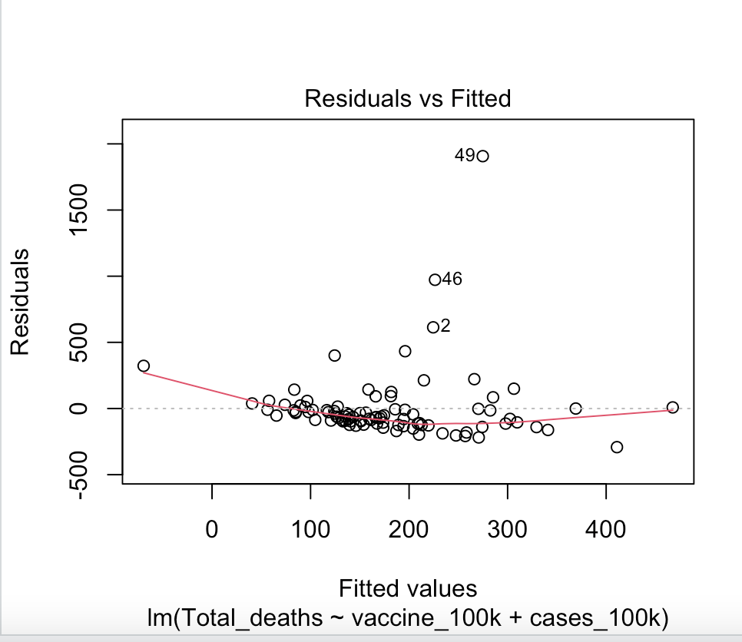
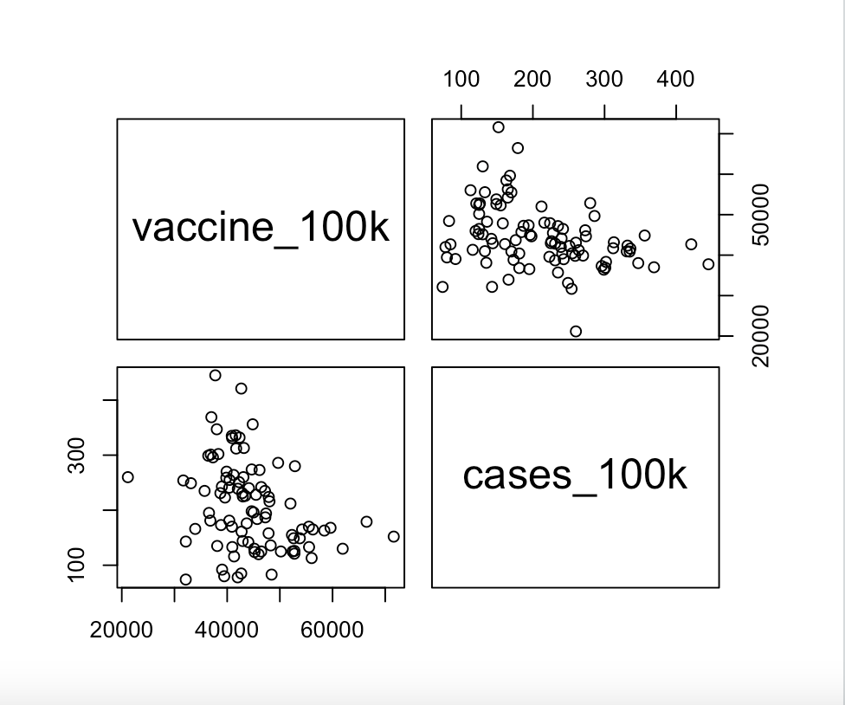
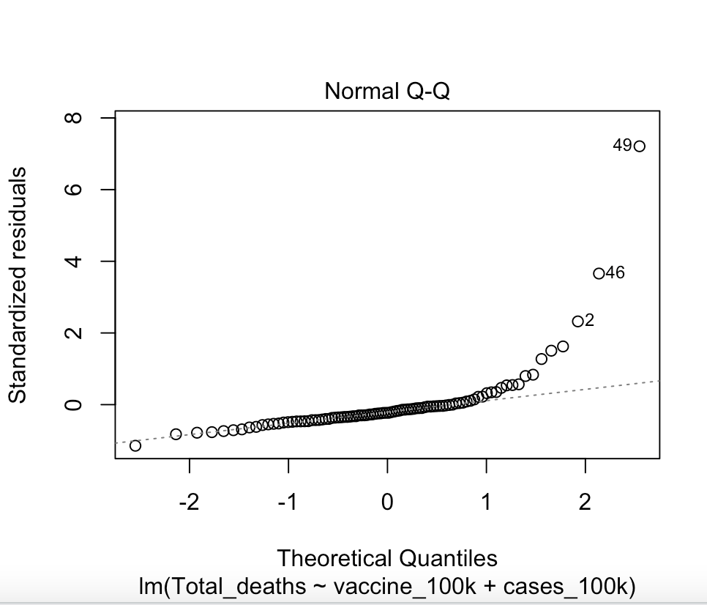
Preliminary Analysis
Residual Plot shows non-constant variance
Initial Regression Equation: Total_deaths~vaccination_100k + cases_100k
Initial Regression: Y=-2.610e+02 + 1.041e-02*X₁ -1.101e-01*X₂
No multicollinearity issues
2 potentially Y influential cases: 49 and 46
Shapiro plot shows potential normal distribution violation
Notes:
Running our preliminary analysis we found normality issues in our data throughout the normal QQ plot and a non random residual plot. We also checked for multicollinearity and were fortunate to not find any multicollinearity issues in the data. When checking for influential cases we found 2 possible cases that could be excluded.

Slide 11
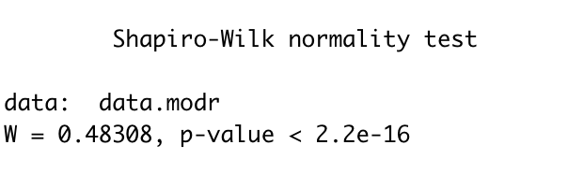
Model Building and Diagnostics
Checking Influential Cases:
Remedial Measure used: Studentized Deleted Residuals (SDR)
SDR compared to t critical value of: 2.87953
If SDR>t: Reject that case is not an outlier with respect to Y
Case 46 (LaPorte County)
Score: 3.94664
Fail to reject
Case 49 (Marion County)
Score: 11.1163
Fail to Reject
Both are outliers with respect to Y
Decision was made to keep these cases due to their importance (Some of the largest counties in Indiana)
Removing outliers didn’t improve model and allowed other points to have the same amount of influence
Robust Regression:
Used as alternative to discarding outliers/ dampens influence of these cases
Reduces residual standard error from 268.619 to 62.71832
Robust Regression Equation: Y=-96.0534 + 0.0042*X₁ + 0.0447*X₂
Shapiro Test still show violations of normality
Notes:
After running analysis on these 2 points we found that these points should in fact be ruled as outliers in the data because the t score of 3.95 and 11.15 are both greater than our critical t value of 2.88. However, we decided to keep them in our data set because they are 2 of the largest counties in Indiana so we wanted to keep them in for accuracy purposes. Also removing outliers in our model did not improve with any significance. We next decided to run a robust regression instead of discarding outliers in aims to dampen the influence of outlier cases. After the robust regression we saw a significant reduction in residual standard error from 268.62 down to 62.72, however we were still faced with a normality violation referenced from the very low shapiro test p-value of 2.2 times 10 to the -16.

Slide 12
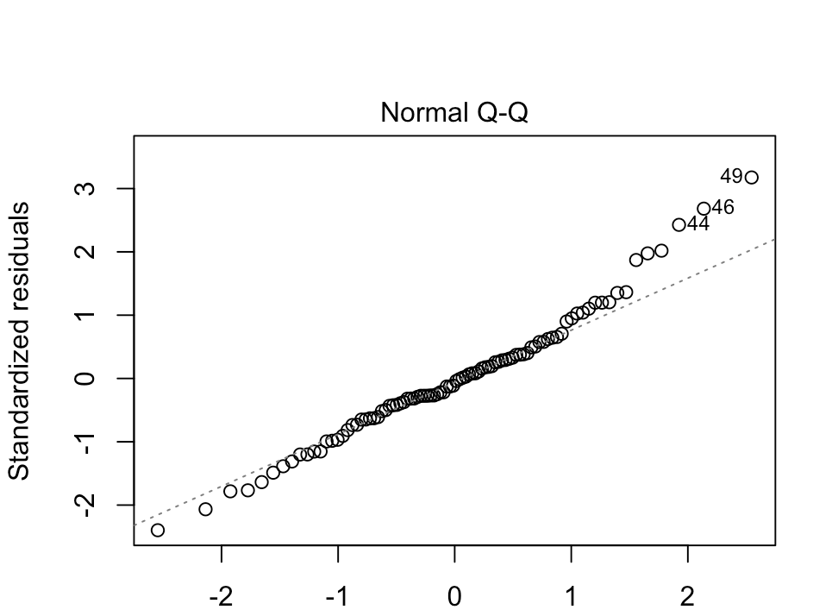
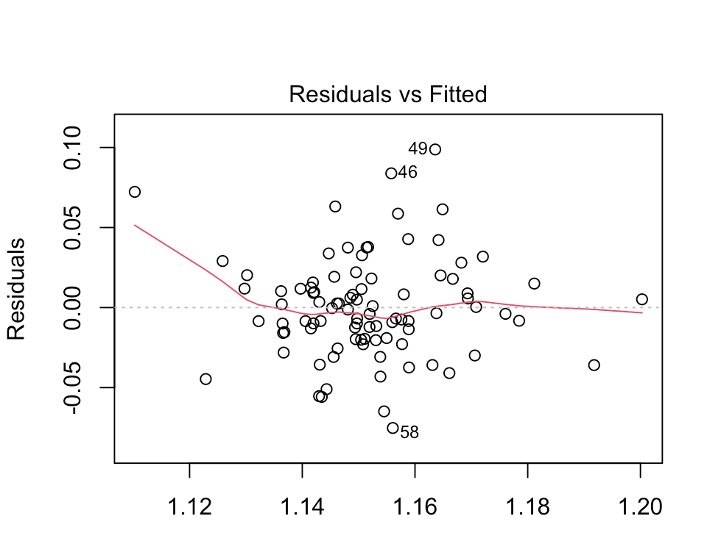
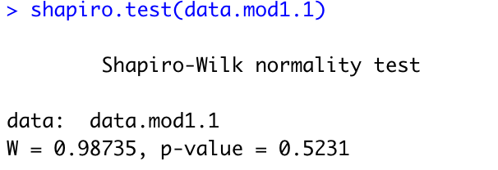
Model Building and Diagnostics
Transformation on Y:
Box Cox transformation
Lambda = -0.091
New Regression Equation: Y=8.154e-01-3.144e-06*X₁ -8.518e-05*X₂
New shapiro plot improves
Residual Plot shows lack of consistency
Passes both shapiro test and bf test
Transformation fixed non-normality
Notes:
In order to fix the normality violation we decided to transform on Y. We first ran a box cox transformation to obtain a lambda value of -0.091, after our equation is transformed we saw improvement in the shapiro test p-value to 0.5231. We can also analyze the normal plot to confirm that we now have random residuals showing non-constant variance and now a normal QQ plot.

Slide 13
Final Model Report and Conclusion
Research Question 1 Hypothesis Test:
Determine if B₁=0
F-Value: 15.9550
P-value: 0.0001333
Determine if B₂=0
F-Value: 1.3435
P-value: 0.2495156
Research Question 1 Conclusion:
The explanatory variable Vaccination_100k (B₁) shows significance
Reject Null that B₁=0
The explanatory variable Cases_100k (B₂) does not show significance
Fail to reject null that B₂=0
With an increase in 1 percent of B₁, the death rate of COVID will fall
Studies have shown the vaccine helps prevent the spread of Covid
Transformed Y:
Fixes non-normality
Adjust R squared improves from 0.07093 to 0.1439
Root MSE improves from 268.62 to 0.0532
Dampening influence of outliers improved model but did not solve non-normality issue
Back transform model to make further conclusions
Notes:
After transforming our Y variable (total_deaths) we were able to confirm that the explanatory variable vaccination_100k shows significance while the variables cases_100k does not show significance. Meaning that we should reject the null hypothesis that beta 1 equal 0 and we fail to reject that beta 2 equals to zero. We were also able to see our R^2 value improve from 0.071 to 0.144. Our standard error also improved drastically from 268.62 to 0.0532. We found that if as little as 1% more of the population gets vaccinated we will be able to observe a fall in the mortality rate. This conclusion falls in line with other research, meaning that the vaccine helps prevent the spread and death from COVID-19.

Slide 14
Research Question 2
Do demographic factors such as age and gender have a significant linear effect on the COVID death rate/population of each county?
Notes:
Our second research question aims to test the same response variable, total_deaths, however while using explanatory variables such as as age and gender. We are testing to see if Age and gender have a significant linear effect on the covid-19 mortality rate by county.

Slide 15
Variables
M_F_diff_100k: Difference between number of male and female deaths (by county) per 100k population/negative indicates more female deaths/ positive indicates more male deaths
avg_death_age: Average age of Covid death
Total_deaths: Total number of COVID-19-related deaths within county (death rate)
Notes:
For this research question we used a variable that measures the difference between male and female deaths over the county population and then multiplied that by 100,000 for a standard population size. In order to test for death age we used data that counted the number of deaths from a range of age groups 0 to 80+ and then we found the average death age from COVID-19 per county. And finally we used the same response variable total deaths from the first question.

Slide 16
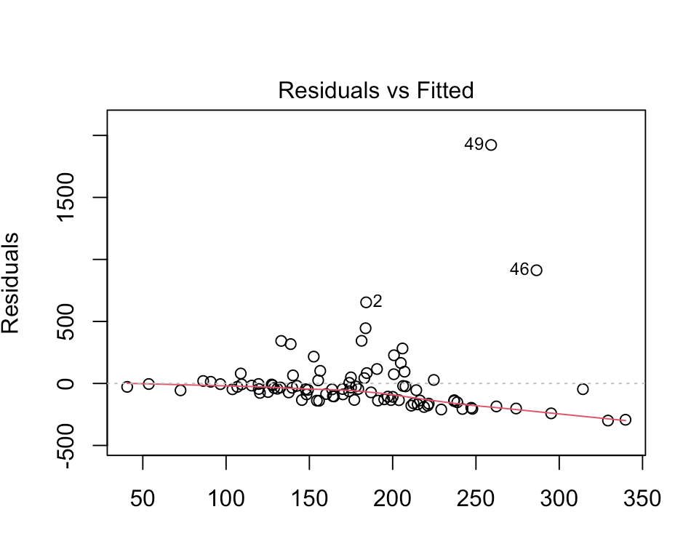
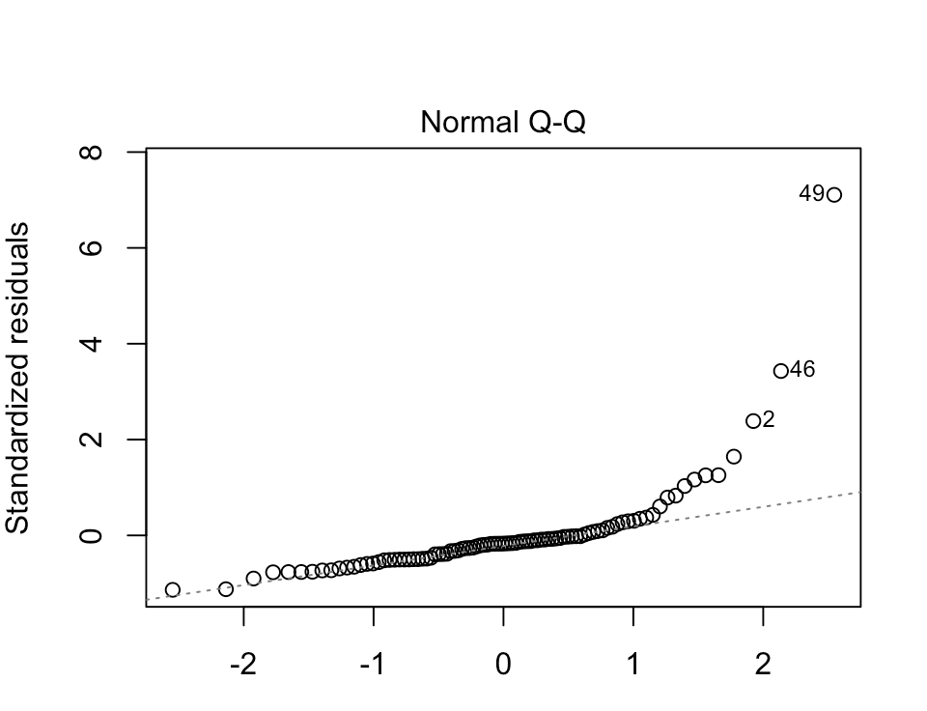
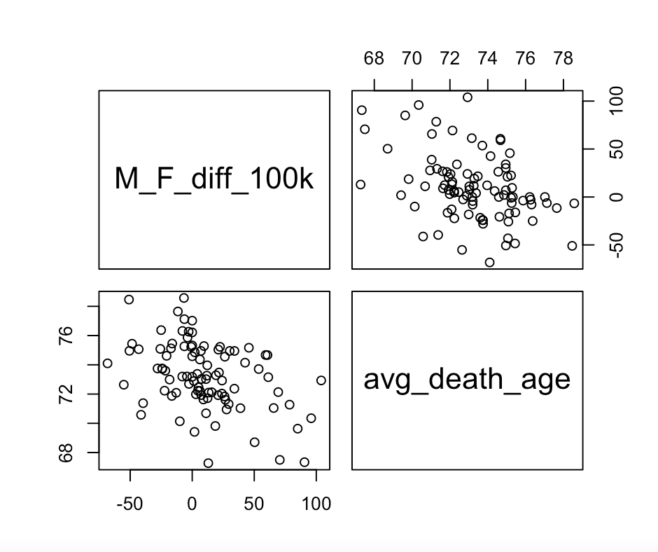
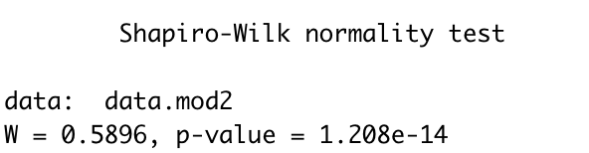
Preliminary Analysis
Initial Regression Equation: Total_deaths~M_F_diff_100k+avg_death_age
Initial Regression: Y=1821.3437+ 0.3483*X₄-22.4692*X₃
No multicollinearity issues
Shapiro Plot highlights potential normal distribution violation
Residual Plot shows non-constant variance
Notes:
Running our preliminary analysis we found normality issues in our data through the normal QQ plot and non-constant variance through a non random residual plot. Our low p-value of 1.21 times 10 to the negative 14 from our shapiro test also confirm the normality flaw. We also checked for multicollinearity and were fortunate to not find any multicollinearity issues in the data.

Slide 17
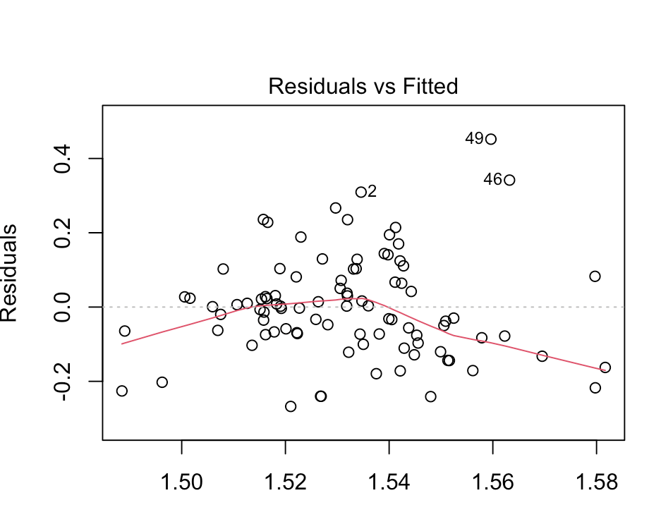
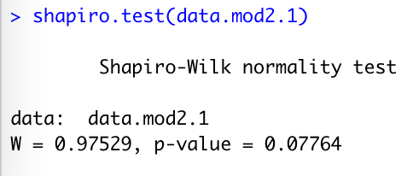
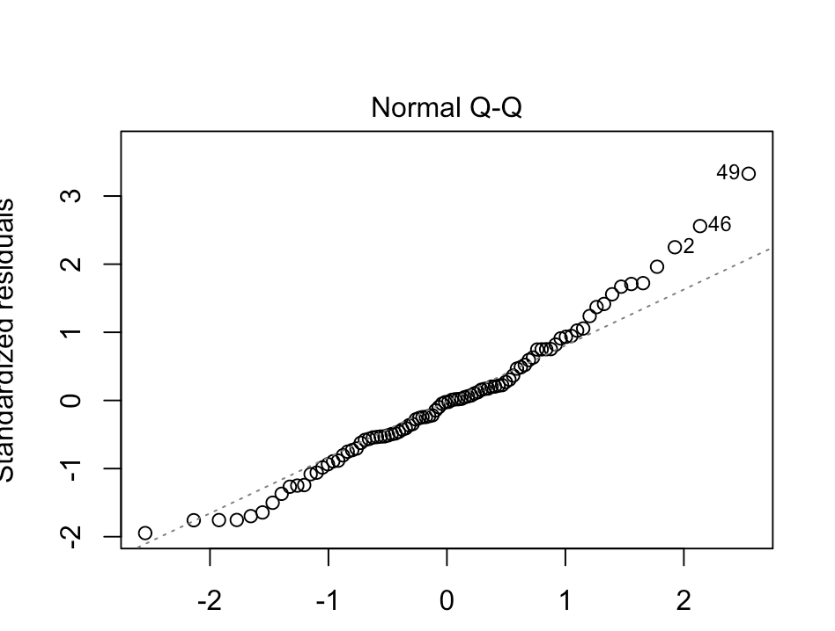
Model Building and Diagnostics
Passes bf test
Violates shapiro test
Transformation on Y:
Box Cox transformation
Lambda = -0.091
New Regression Equation: Y=2.116+3.201e-05*X₄-7.973e-03*X₃
New Shapiro Plot improves
Passes both shapiro and bf test
Transformation fixed non-normality
Residual Plot seems to have worsened
Shapiro Plot improved
Notes:
In order to fix the normality violation we decided to transform on Y. We ran a box cox transformation to obtain a lambda value of -0.091, after our equation is transformed we saw improvement in the shapiro test and bf test. We can also analyze the normal QQ plot to confirm our finding. finally, we also now have random residuals in our initial plots function.

Slide 18
Final Model Report and Conclusion
Transformed Y:
Fixes non-normality
Adjusted R Squared worsens/ becomes not possible: From 0.02071 to -0.003796
Root MSE improves from 275.7843 to 0.1384608
Quick Robust Regression also proved similar results (Unusable R squared)
Research Question 2 Hypothesis Test:
Determine if B₄=0
F-Value: 0.3517
P-value: 0.5546
Determine if B₃=0
F-Value: 1.3042
P-value: 0.2565
Research Question 2 Conclusion:
Neither explanatory variable shows significance
Fail to reject Null that B₄=0 or B₃=0
Low R squared values show model is poor
SLR of each individual predictor shows small R squared values
Both variables are insignificant and neither do a good job explaining the response
Notes:
After transforming our Y variable (total_deaths) we were not able to confirm that either of the explanatory variable gender or age shows any significance. Therefore we would fail reject both null hypothesis’ that Beta 4 & 5 are equal to 0. We found that our transformation on Y helped our normality violation, and that our standard error improves significantly, however it decreased our R^2 value. After running a quick robust regression it also confirmed similar results. Our low R^2 values show that our model is poor and disproves our null hypothesis that COVID-19 death rate can be explained linearly by gender and age, neither of these variables do a good job of explaining our response.

Slide 19
Research Question 3
Does the amount of high-risk people living in a county have a significant linear impact on the COVID death rate?
Notes:
Our third research question asked if the amount of high-risk people living in a county had a significant linear impact on the COVID death rate.

Slide 20
Variables
High_risk_100k: Proportion of people per 100k that are considered high risk
Total_deaths: Total number of COVID-19-related deaths within county (death rate)
Notes:
The variables we are using for this question are our high risk variable, which shows the proportion of people per 100k that are considered high risk per county. The other variable we are using is our response variable, total deaths, which measures the total number of Covid-19 related deaths within a county.

Slide 21
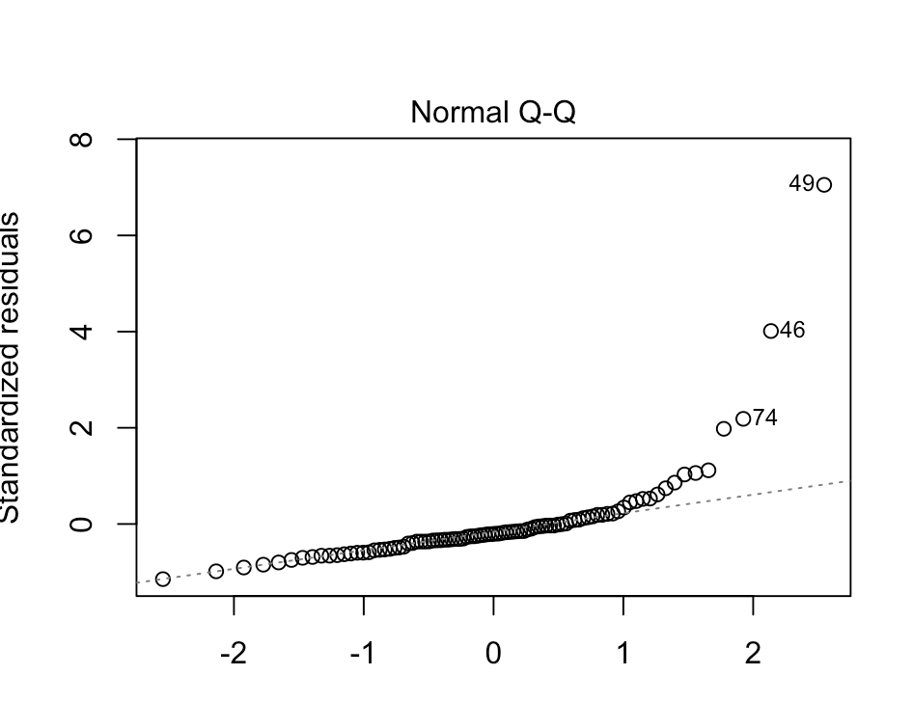
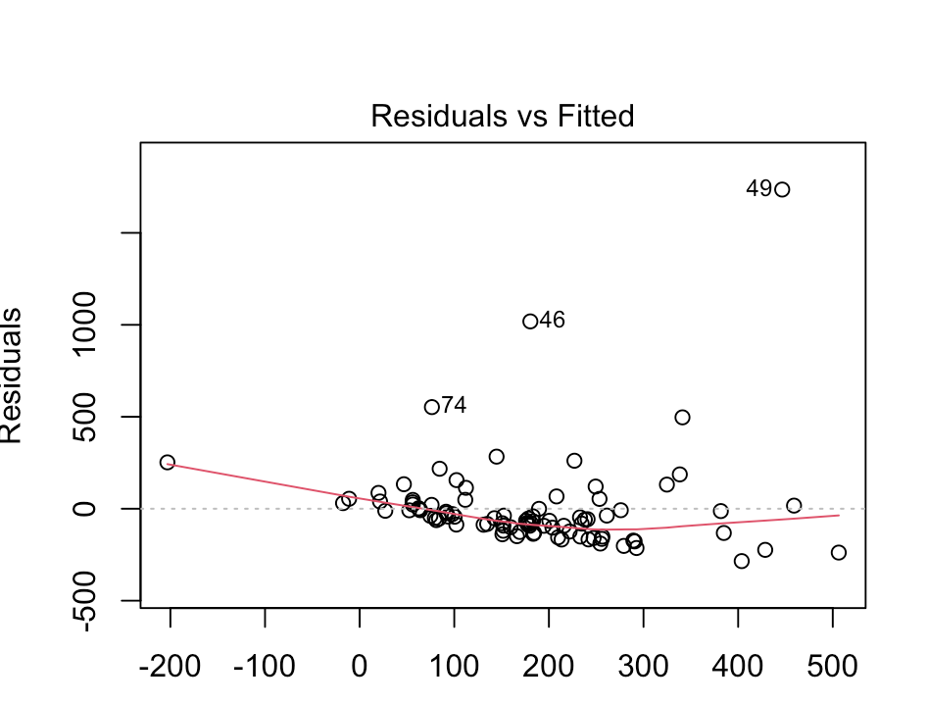
Preliminary Analysis
Initial Regression Equation: Total_deaths~high_risk_100k
Initial Regression: Y=1116.95950+ -0.05421*X₅​​
No multicollinearity issues/ SLR model
Shapiro Plot highlights potential normal distribution violation
Residual Plot highlights potential non-constant variance issue
Notes:
After plotting our initial model, we were able to highlight a potential normal distribution violation and a potential non-constant variance due to outliers. Multicollinearity is not an issue in this model since we are using SLR.

Slide 22
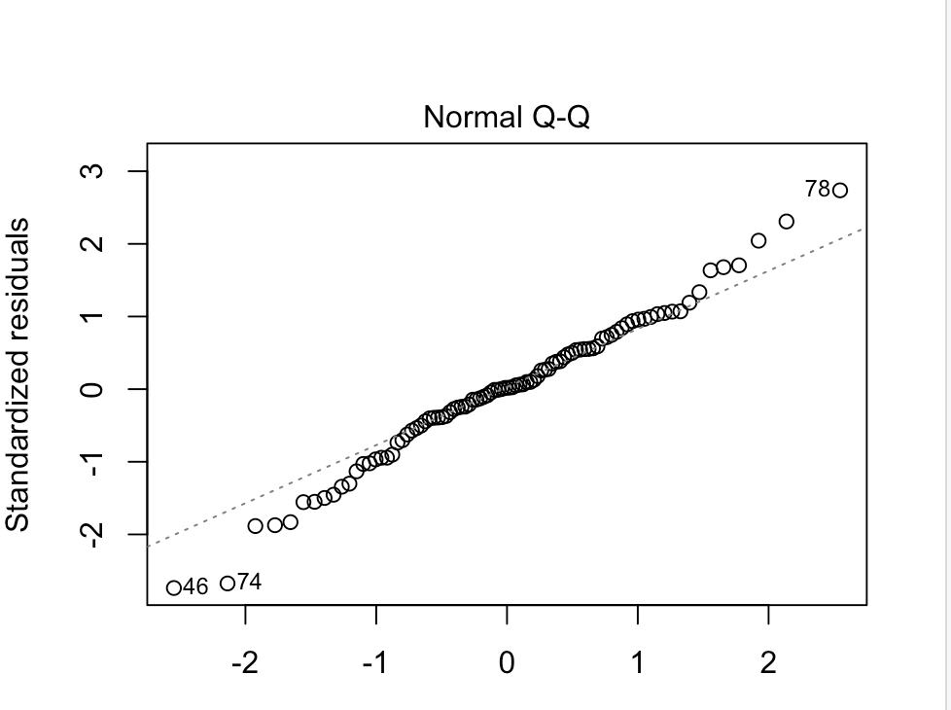
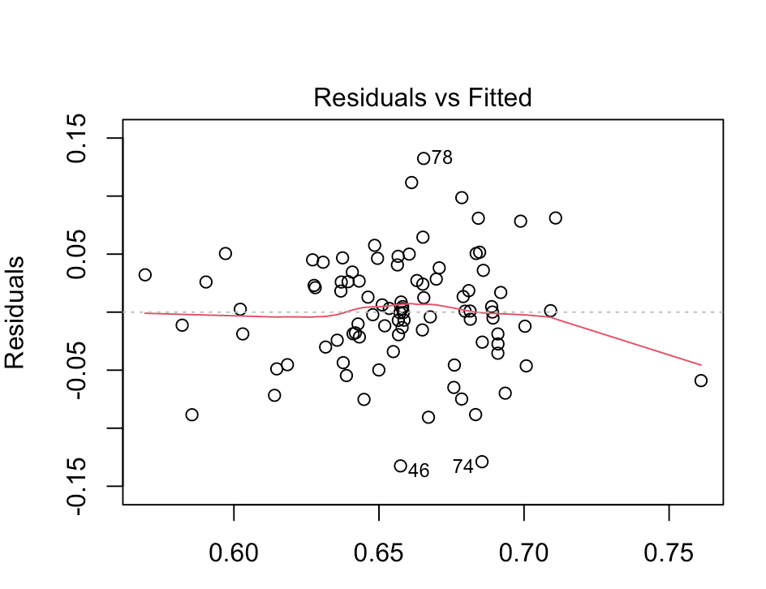
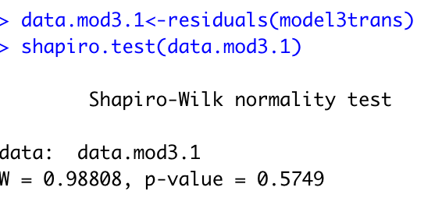
Model Building and Diagnostics
Transformation on Y:
Box Cox transformation
Lambda = -0.091
New Regression Equation: Y=4.045e-01+1.464e-05*X₅​​
New Shapiro Plot improves
Passes both shapiro and bf test
Transformation fixed non-normality
Residual Plot seems to have worsened
Shapiro Plot improved
Notes:
To fix our normality issue, we used a box cox transformation on our Y variable. Using a lambda of -0.091, we obtained a transformed regression equation with an intercept of 0.4045 and a Beta 5 of 1.464e-05. Our new plots show improvement within normality, but not with constant variance. However, our transformed model still passes our bf test, and now also solves our normality issue by passing our shapiro test.

Slide 23
Final Model Report and Conclusion
Research Question 2 Hypothesis Test:
Determine if B₅=0
F-Value: 37.068
P-value: 2.752e-08
Research Question 2 Conclusion:
High Risk variable shows significance
Reject Null that B₅=0
With an increase in 1 percent of B₅, the death rate of Covid will rise
The more at risk people there are, the easier it will be for these people to gain and spread Covid
At Risk people have a harder time fighting the virus, due to old age or other health conditions
This results in higher death rates for Covid
Transformed Y:
Fixes non-normality
Adjusted R Squared improves from 0.161 to 0.2838
Root MSE improves from 255.2685 to 0.04865182
Must back transform model to make further conclusions
Notes:
With our fixed normality issue, our transformed model improves our R squared value from 0.161 to 0.2828. It also massively improves our root MSE value from 255 to 0.0487. However, in order to make further conclusions about our model, we must back transform. When forming our conclusions, we found our high risk variable to be significant with a p-value of less than 0.05. Therefore, we would reject our null hypothesis. With an increase of 1 percent of the proportion of people per 100k that are considered high risk, the death rate of Covid will rise. This can be explained by at risk people have a harder time fighting the virus, due to old age or other health conditions weakening their immune system. This results in higher Covid death rates among people of high risk.

Slide 24
Finding the Best Model
What are the best predictors for the model/ what gives us our highest adjusted R-squared?
Notes:
Finally, we wanted to find out which predictors gave us the best model to predict Total deaths.

Slide 25
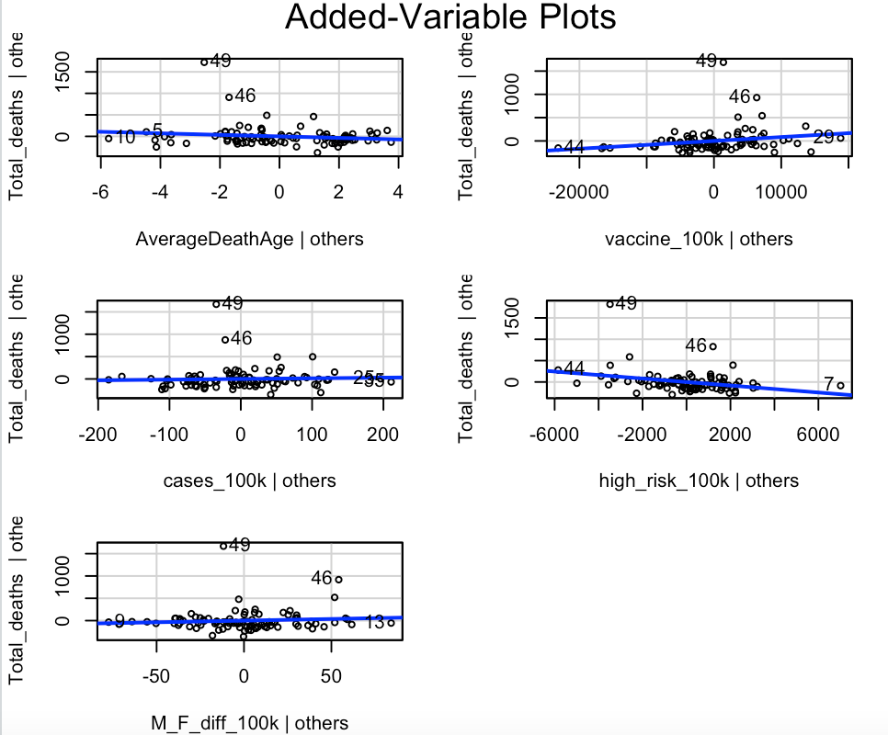
Best Subsets/ Stepwise Model
Relatively low R squared values for all models
Remedy: Combine all predictors and find the best model through best subset and stepwise
We want combine all our predictors to see which predictors/ models are best for explaining Covid mortality rate in Indiana
New regression function: Total_deaths~AverageDeathAge+vaccine_100k+cases_100k+high_risk_100k+M_F_diff_100k
New regression: Y = 1.785e+03 + 8.381e-03*X₁+1.495e-01*X₂-1.786e+01*X₃+7.498e-01*X₄-4.098e-02*X₅
Added-Variable Plots show add-on values in vaccine_100k, and high_risk_100k
Notes:
To do this, we combined all of our used predictors from our previous models into 1 model. Since we had relatively low r squared values for all our research question models, we hoped this would help us not only find the best predictors, but also significantly raise our r squared value. Our new regression function consisted of Total deaths regressed on vaccine rate, infection rate, high risk, and male/ female difference. Our new equation contained an intercept of 1.785. Our added variable plots, shown to the right, display how the variables of AverageDeathAge, vaccine_100k, and high_risk_100k show add-on value.

Slide 26
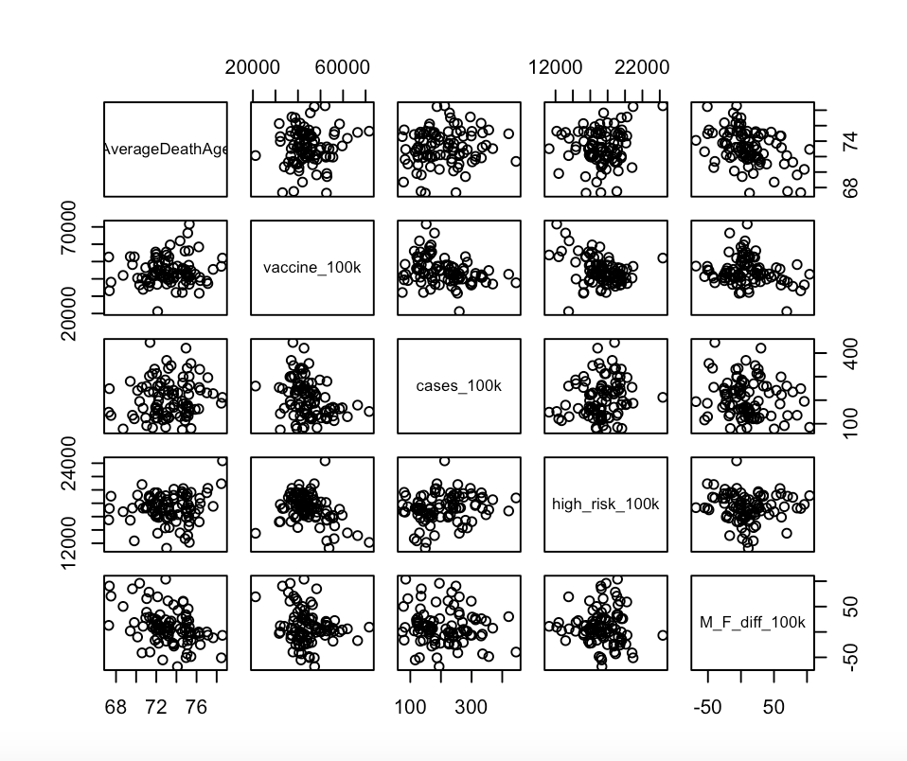
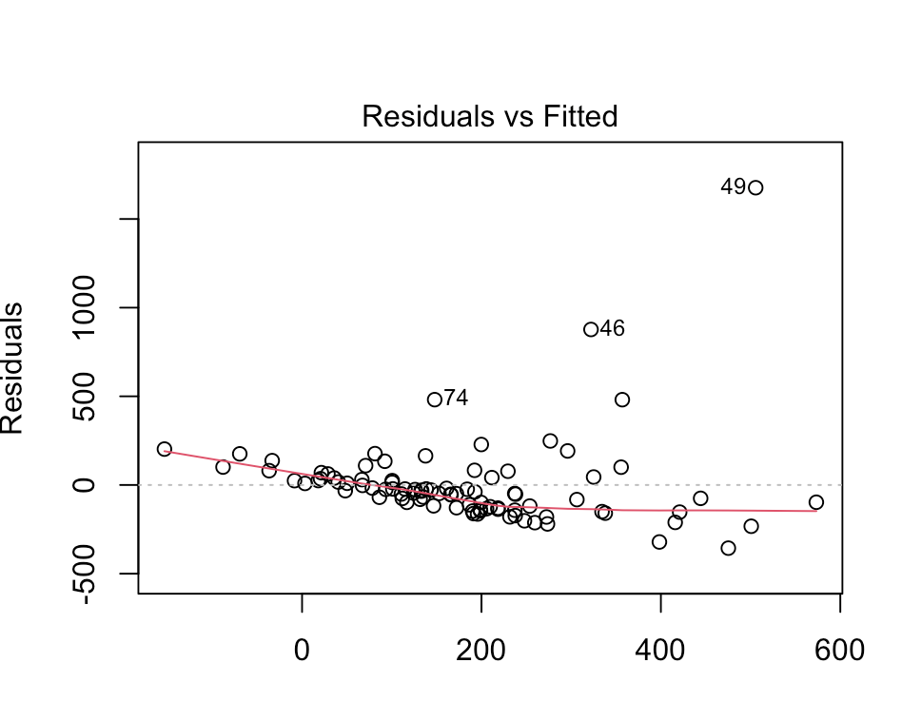
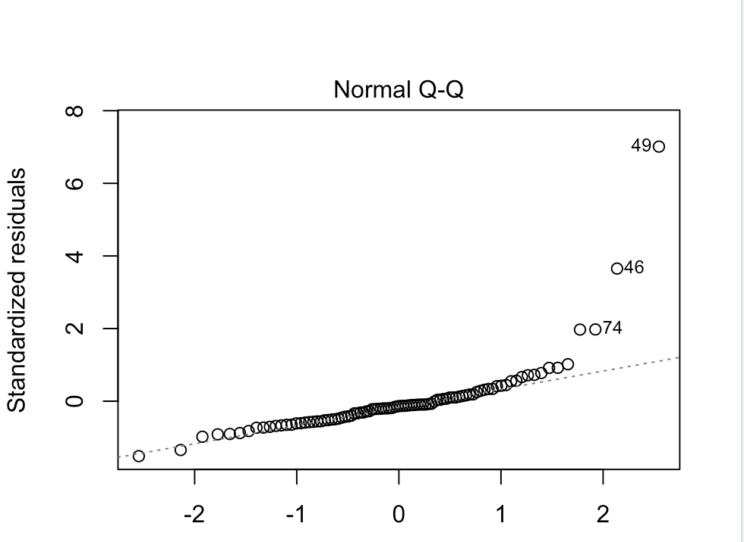
Preliminary Analysis
No major multicollinearity issues
Residual plot shows possibility of non-constant variance
Shapiro Plot shows potential normal distribution violation
Notes:
From our scatterplot, we can observe that no variables display a serious multicollinearity issue. As per usual, our shapiro and residual plot show possible violations in variance and normality. However, after running a bf and shapiro test, we discover that there is only a significant violation on normality.

Slide 27
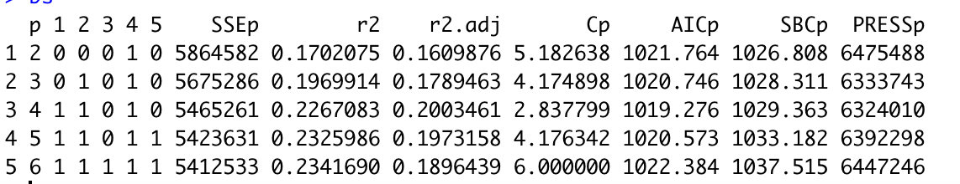
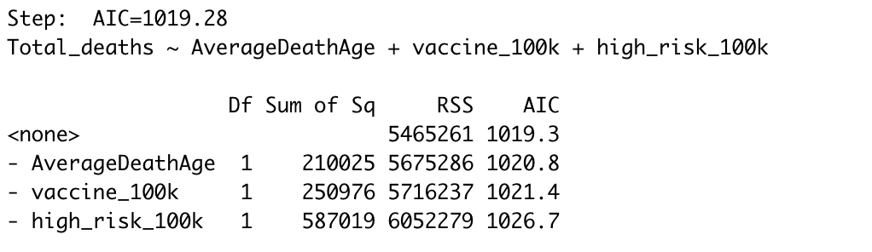
Model Building and Diagnosis
Finding Best Model (Best Subsets):
Provide the best subsets according to specified criterion
Model with best predictors provided:
Highest adjusted R squared
Lower Cp
Lowest AICp
Lowest PRESSp
Finding Best Model (Stepwise):
Measure used to see which of the explanatory variables is suggested to be dropped by R
Can be used to validate result of Best Subset (Model chosen has lowest AICp)
Stepwise suggested to drop cases_100k and M_F_diff_100k
Full model: AIC=1022.38
Stepwise suggested: AIC=1019.28
Notes:
Initially, to find our best model, we used the best subset function to help us find the best predictors to include. The model we ended up choosing had 3 predictors, AverageDeathAge, vaccine_100k, and high_risk_100k. This model had the highest adjusted R squared of #, the lowest Cp of #, the lowest AICp of #, and the lowest PRESSp of #. Since we were looking for best predictors, we would choose the model with the lowest PRESSp. However, we knew we could confirm our findings with stepwise since we also used the model with the lowest AICp. We used stepwise to see which of the explanatory variables can be dropped. Our stepwise validated our best subsets, and concluded we could drop cases_100k and M_F_diff_100k. These were also not included in our best subset model.

Slide 28
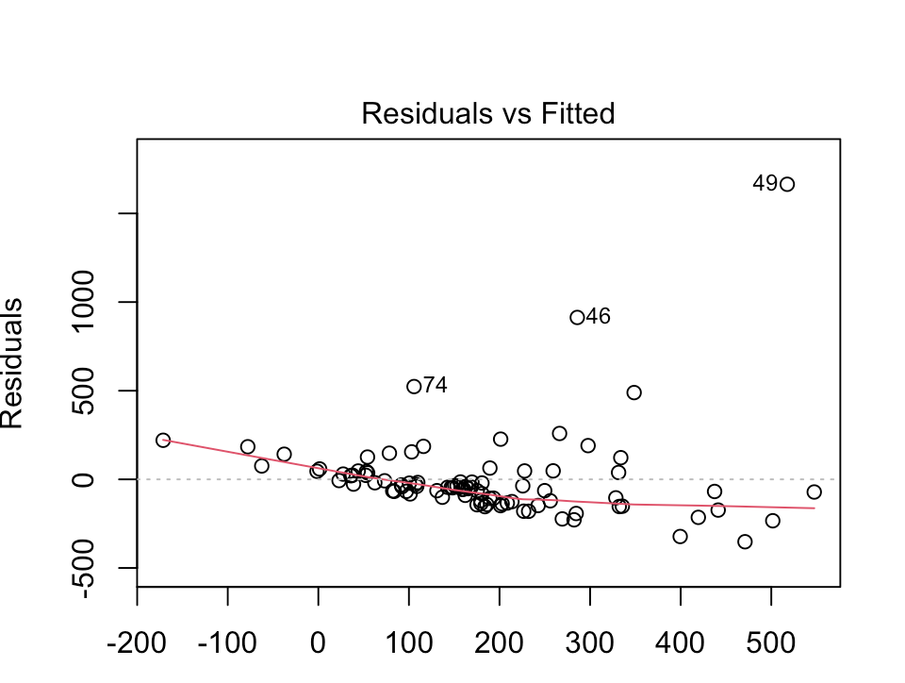
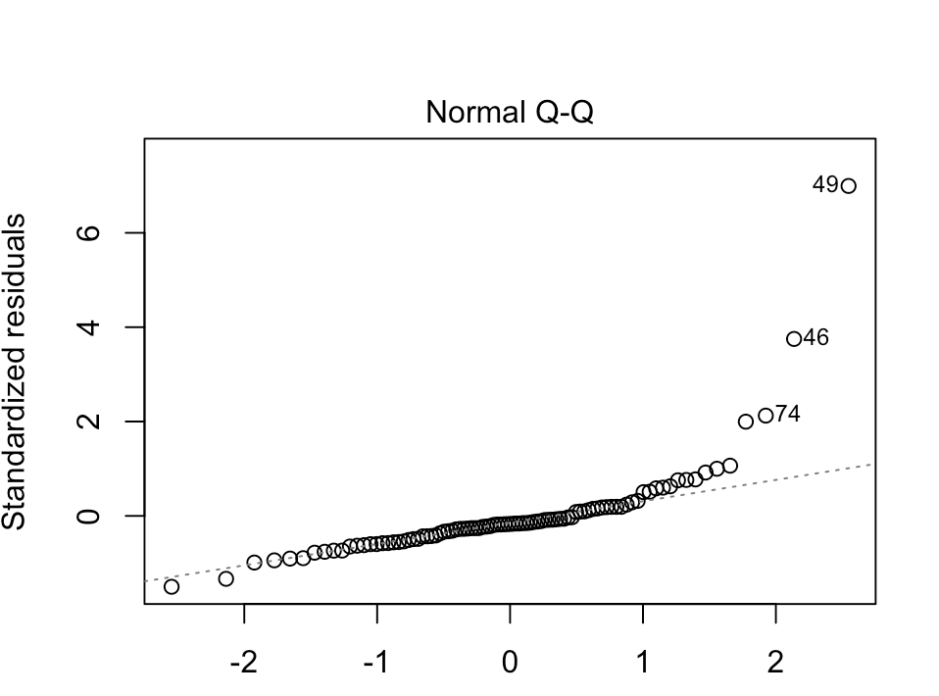
Model Building and Diagnosis
Best Model:
New Regression: Total_deaths~AverageDeathAge+vaccine_100k+high_risk_100k
Regression Equation: Y=2.145e+03+7.319e-03*X₁-2.153e+01*X₃-4.131e-02*X₅
Slight increase in adjusted R-Squared: From 0.1896 to 0.2003
Very small improvement in Root MSE: From 250.8705 to 249.2087
Variance looks non-constant, but passes bf test
Shapiro shows non-normality, but this is expected
Notes:
After determining our best model, we ran our new regression as Total_deaths~AverageDeathAge+vaccine_100k+high_risk_100k. Our new regression equation had an intercept of #. Our R squared also slight improved from the full model with every predictor, improving from 0.1896 to 0.2003. We also had a very small improvement in our Root MSE, moving from 250.8705 to 249.2087. In our new plots, we can still view possible non-constant variance and normality violations. After further testing is done through bf and shapiro tests, we find that there still is only a violation on normality.

Slide 29
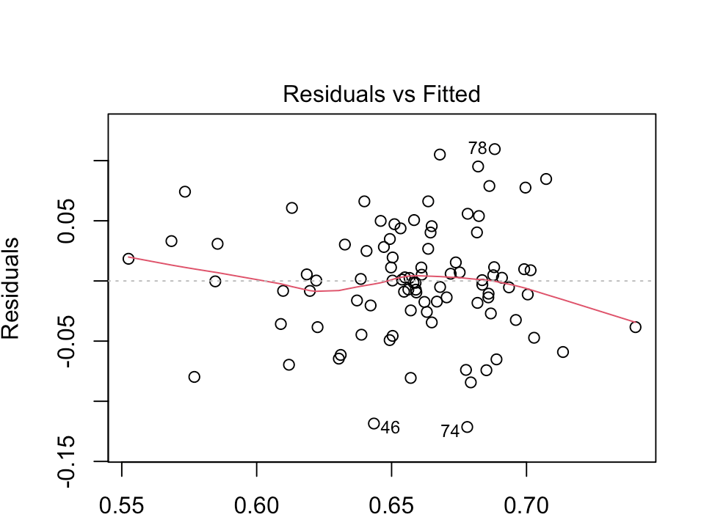
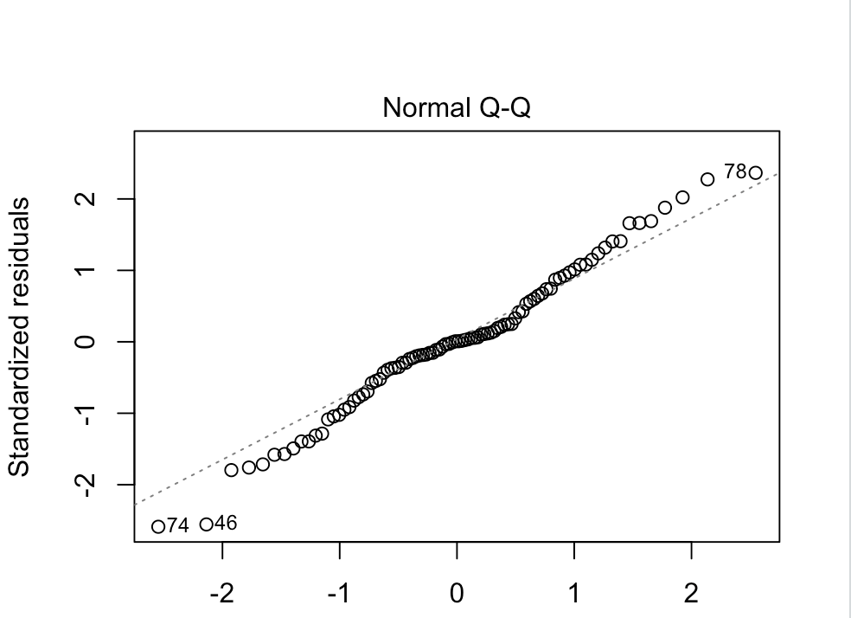
Model Building and Diagnosis
Transformation on Y due to normality violation:
Box Cox transformation
Lambda=-0.091
New Regression Equation: Y=3.768e-01-1.741e-06*X₁+2.050e-03*X₃+1.204e-05*X₅
New Shapiro plot improves
Passes both bf test and shapiro test
Non-normality fixed
Adjusted R-squared improves from 0.2003 to 0.3186
Root MSE improves significantly from 249.2087 to 0.04746
Notes:
Because of our violation on normality, we once again decided to transform Y. We again used a boxcox transformation with a lambda of -0.091. After transformation, we obtain a new regression equation with an intercept of #. We tested our transformed data again with bf and shapiro tests, and found no more violations. Our transformation also improved our adjusted R squared, moving from our original model of 0.2003 to 0.3186. Our root MSE improves massively, shrinking down from 249 to 0.04746.

Slide 30
Model Building and Diagnosis
K-cross Validation:
Extension of leave-one-out cross-validation that reduces the similarity among the training datasets
Root MSE = 0.04768122
Validates results of both best subsets and stepwise algorithm
Compare to other two results: Barely larger RMSE
Notes:
To validate our model one last time, we took our three best subset models and out them through a K cross validation. This would validate our best model by reducing the similarity among our so called training datasets. As you can see from the output, our K-cross validation of all three models confirmed that our best model was selected, Modelbest3. Our best model barely had the lowest root MSE of 0.0468. In terms of prediction power of this model, we are limited by our 5 selected prediction variables. We also found that only two of our prediction variables are significant. Because of this, our prediction power is limited by these insignificant variables. Finding and adding more significant variables from Indiana county demographics would be something we would change for the future to help us increase our prediction power.

Slide 31
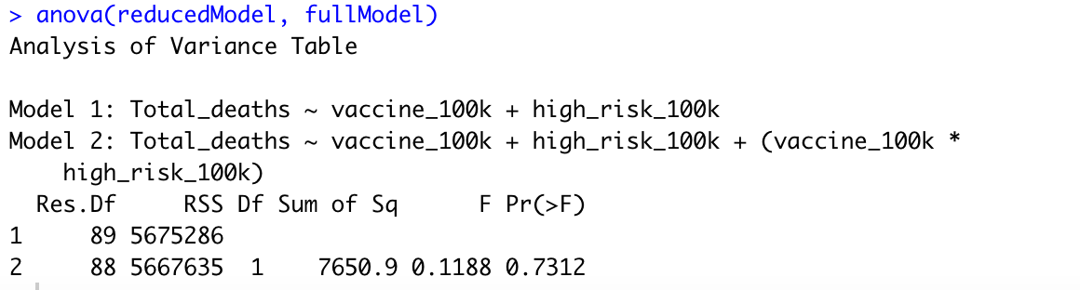
Model Building and Diagnosis
Hypothesis testing to check for interaction between vaccine_100k and high_risk_100k
H0: Binteraction = 0 (Y=B0 + B₁X₁+B₅X₅)
Ha: Binteraction ≠0 (Y=B0 + B₁X₁+B₅X₅+Binteraction(1)*X₁*X₅)
GLT test results:
p-value>0.05: Fail to reject our null hypothesis
There is no significant interaction between vaccine rate and high risk
Notes:
Finally, we also wanted to do a GLT test to make sure the interaction between our two significant variables, vaccine_100k and high_risk_100k, was not significant. Our null hypothesis stated that there was no significant interaction between the two variables, and our alternative hypothesis stated that the interaction was significant. After running the test, we were able to confirm from the output that the interaction was not significant, having a P-value greater than 0.05. Therefore, we failed to reject our null hypothesis.

Slide 32
Final Model Report and Conclusion
Best Model Conclusions:
After analyzing our best model, we were able to confirm that both our vaccine and high risk variables had a significant linear impact on total deaths.
Vaccine rate has a significant and negative impact on total Covid deaths
High risk has a significant and positive impact on total Covid deaths
Our average age of death variable proved to be positive, but insignificant
As stated before, Covid vaccines help protect individuals from the spread of Covid
High risk individuals would have a harder time fighting the virus due to a weakened immune system
Notes:
Ultimately, these two variables have been known to impact the death rate of Covid, and our best model confirms these findings. This study is limited by an overall lack of data available. With Covid being relatively knew, there is still constantly new discoveries and new data being released. The data available to us right now is more limited than it would be in the future. In the future, we would change our study by testing different areas of the country rather than just counties in Indiana. With recent political and cultural bias affecting how people view vaccines and Covid in general, expanding our study into more culturally and politically diverse areas could give us a better prediction of the truly significant impact of our variables.

Slide 33
References
Conduent Healthy Communities Institute. (2021). Locating at-risk populations. COVID-19. Retrieved December 8, 2021, from https://www.covid19atrisk.org/at-risk.html?state=IN.
Reno Gazette Journal. (2021). Covid-19 vaccine tracker | rgj.com. Reno Gazette Journal. Retrieved December 8, 2021, from https://data.rgj.com/covid-19-vaccine-tracker/.
State of Indiana. (n.d.). Indiana Coronavirus Dashboard. ISDH - Novel Coronavirus: Novel Coronavirus (COVID-19). Retrieved December 8, 2021, from https://www.coronavirus.in.gov/.
Sykes Enterprises. (2021). Study: Best covid-19–fighting states in the U.S. SYKES. Retrieved December 8, 2021, from https://www.sykes.com/resources/reports/2021-best-worst-covid19-fighting-states-america/.
The New York Times. (2020, April 1). Indiana coronavirus map and case count. The New York Times. Retrieved December 8, 2021, from https://www.nytimes.com/interactive/2021/us/indiana-covid-cases.html.
Notes:
Thank you.

